Slide 1
GENETIC ALGORITHMS
Course Code: CSC4226
Course Title: Artificial Intelligence and Expert System
Dept. of Computer Science
Faculty of Science and Technology
Lecture No: | Five (5) | Week No: | Five (5) | Semester:
Lecturer: | Dr. Ashraf Uddin dr.ashraf@aiub.edu

Slide 2
Lecture Outline
Local Search
Local Search Algorithms and Optimization Problems
Hill Climbing Search
Simulated Annealing
Local Beam Search
Evolutionary Algorithms
Genetic Algorithms

Slide 3
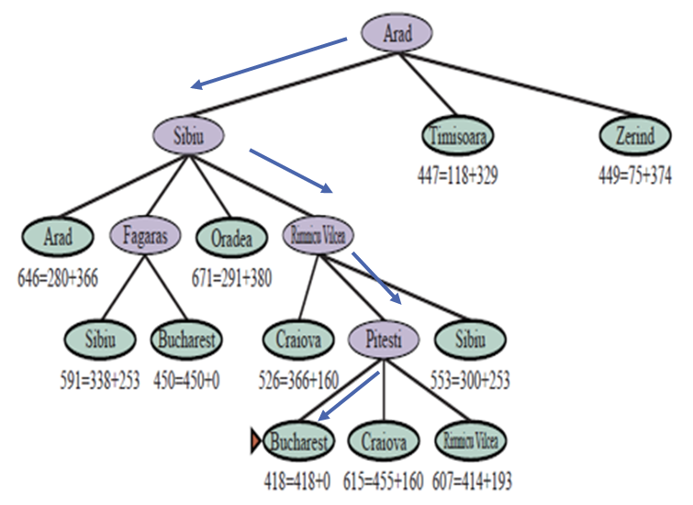
Search in Complex Environment
Classical search problems addressed problems in fully observable, deterministic, static, known environments where the solution is a sequence of actions.
In this chapter, we relax those constraints. We begin with the problem of finding a good state without worrying about the path to get there, covering both discrete and continuous states.

Slide 4
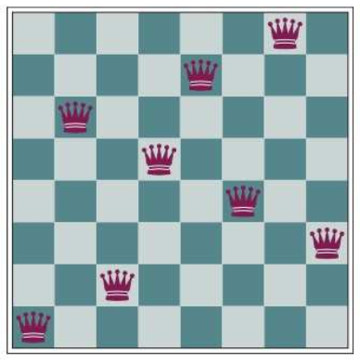
Local Search and Optimization Problems
In the search problems discussed earlier, we wanted to find paths through the search space, such as a path from Arad to Bucharest.
But sometimes we care only about the final state, not the path to get there. For example, in the 8-queens problem, we care only about finding a valid final configuration of 8 queens.
This is also true for many important applications such as integrated-circuit design, factory floor layout, job shop scheduling, automatic programming, telecommunications network optimization, crop planning, and portfolio management.
The 8-queens problem: place 8 queens on a chess board so that no queen attacks another. This position is almost a solution, except for the two queens in the fourth and seventh columns that attack each other along the diagonal.

Slide 5
Local Search and Optimization Problems
Local search algorithms operate by searching from a start state to neighboring states, without keeping track of the paths, nor the set of states that have been reached.
That means they are not systematic—they might never explore a portion of the search space where a solution actually resides.
However, they have two key advantages:
they use very little memory; and
they can often find reasonable solutions in large or infinite state spaces for
which systematic algorithms are unsuitable.

Slide 6
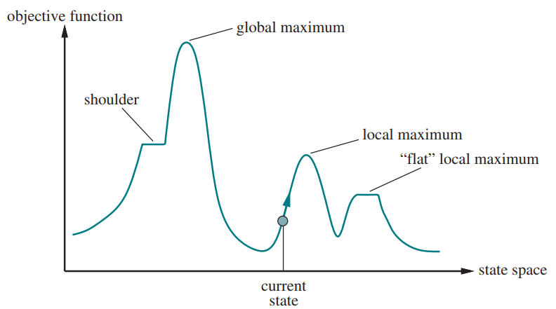
Local Search and Optimization Problems
Local search algorithms can also solve optimization problems, in which the aim is to find the best state according to an objective function.
To understand local search, consider the states of a problem laid out in a state-space landscape.
Each point (state) in the landscape has an “elevation,” defined by the value of the objective function.
A one-dimensional state-space landscape in which elevation corresponds to the objective function. The aim is to find the global maximum.

Slide 7
Local Search and Optimization Problems
If elevation corresponds to an objective function, then the aim is to find the highest peak—a global maximum—and we call the process hill climbing.
If elevation corresponds to cost, then the aim is to find the lowest valley—a global minimum—and we call it gradient descent.
A one-dimensional state-space landscape in which elevation corresponds to the objective function. The aim is to find the global maximum.

Slide 8
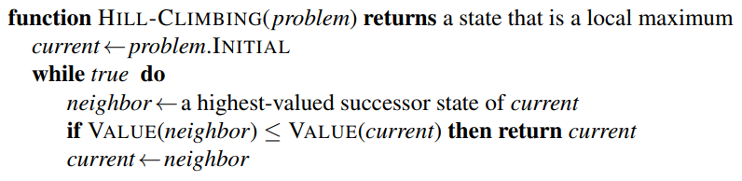
Hill-climbing search
It keeps track of one current state and on each iteration moves to the neighboring state with highest value—that is, it heads in the direction that provides the steepest ascent.
It terminates when it reaches a “peak” where no neighbor has a higher value.
Hill climbing does not look ahead beyond the immediate neighbors of the current state.
Note that one way to use hill-climbing search is to use the negative of a heuristic cost function as the objective function; that will climb locally to the state with smallest heuristic distance to the goal.
The hill-climbing search algorithm, which is the most basic local search technique. At each step, the current node is replaced by the best neighbor.

Slide 9
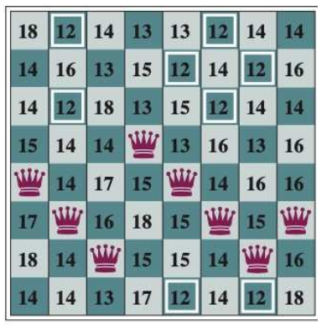
Hill-climbing search
To illustrate hill climbing, we will use the 8-queens problem. We will use a complete-state formulation, which means that every state has all the components of a solution.
In this case every state has 8 queens on the board, one per column.
The initial state is chosen at random, and the successors of a state are all possible states generated by moving a single queen to another square in the same column (so each state has 8×7=56 successors).
An 8-queens state with heuristic cost estimate h=17. The board shows the value of h for each possible successor obtained by moving a queen within its column. There are 8 moves that are tied for best, with h=12. The hill climbing algorithm will pick one of these.

Slide 10
Hill-climbing search
The heuristic cost function h is the number of pairs of queens that are attacking each other; this will be zero only for solutions.
To illustrate hill climbing, we will use the 8-queens problem. We will use a complete-state formulation, which means that every state has all the components of a solution.
An 8-queens state with heuristic cost estimate h=17. The board shows the value of h for each possible successor obtained by moving a queen within its column. There are 8 moves that are tied for best, with h=12. The hill climbing algorithm will pick one of these.

Slide 11
Hill-climbing search
Hill climbing is sometimes called greedy local search because it grabs a good neighbor state without thinking ahead about where to go next.
Hill climbing can make rapid progress toward a solution because it is usually quite easy to improve a bad state.
For example, from the state in the previous slide, it takes just five steps to reach the state in the figure, which has h=1 and is very nearly a solution.

Slide 12
Hill-climbing search
Unfortunately, hill climbing can get stuck for any of the following reasons:
Local maxima: A local maximum is a peak that is higher than each of its neighboring states but lower than the global maximum.
Plateaus: A plateau is a flat area of the state-space landscape. It can be a flat local maximum, from which no uphill exit exists, or a shoulder, from which progress is possible.

Slide 13
Hill-climbing search
Many variants of hill climbing have been invented.
Stochastic hill climbing chooses at random from among the uphill moves; the probability of selection can vary with the steepness of the uphill move. This usually converges more slowly than steepest ascent, but in some state landscapes, it finds better solutions.
First-choice hill climbing implements stochastic hill climbing by generating successors randomly until one is generated that is better than the current state. This is a good strategy when a state has many (e.g., thousands) of successors.
Random-restart hill climbing, conducts a series of hill-climbing searches from randomly generated initial states, until a goal is found. If there are few local maxima and plateaus, random-restart hill climbing will find a good solution very quickly.

Slide 14
Simulated annealing
A hill-climbing algorithm that never makes “downhill” moves toward states with lower value (or higher cost) is always vulnerable to getting stuck in a local maximum.
The overall structure of the simulated-annealing algorithm is similar to hill climbing.
Instead of picking the best move, however, it picks a random move. If the move improves the situation, it is always accepted. Otherwise, the algorithm accepts the move with some probability less than 1.
The probability decreases exponentially with the “badness” of the move.

Slide 15
Local beam search
Keeping just one node in memory might seem to be an extreme reaction to the problem of memory limitations. The local beam search algorithm keeps track of k states rather than just one.
It begins with k randomly generated states. At each step, all the successors of all k states are generated. If any one is a goal, the algorithm halts. Otherwise, it selects the k best successors from the complete list and repeats.
At first sight, a local beam search with k states might seem to be nothing more than running k random restarts in parallel instead of in sequence. In fact, the two algorithms are quite different. In a random-restart search, each search process runs independently of the others.

Slide 16
Stochastic beam search
Local beam search can suffer from a lack of diversity among the k states—they can become clustered in a small region of the state space.
A variant called stochastic beam search, analogous to stochastic hill climbing, helps alleviate this problem.
Instead of choosing the top k successors, stochastic beam search chooses successors with probability proportional to the successor’s value, thus increasing diversity.

Slide 17
Evolutionary algorithms
Evolutionary algorithms can be seen as variants of stochastic beam search that are explicitly motivated by the metaphor of natural selection in biology:
there is a population of individuals (states), in which the fittest (highest value) individuals produce offspring (successor states) that populate the next generation, a process called recombination.
There are endless forms of evolutionary algorithms, varying in the following ways:
The size of the population.
The representation or encoding of each individual. In genetic algorithms, each individual is a string over a finite alphabet (often a Boolean string), just as DNA is a string over the alphabet ACGT.

Slide 18
Evolutionary algorithms
The mixing number, ρ, which is the number of parents that come together to form offspring. The most common case is ρ = 2: two parents combine their “genes” (parts of their representation) to form offspring. When ρ = 1 we have stochastic beam search.
The selection process for selecting the individuals who will become the parents of the next generation: one possibility is to select from all individuals with probability proportional to their fitness score.
The recombination (also known as crossover) procedure. One common approach (assuming ρ = 2), is to randomly select a crossover point to split each of the parent strings, and recombine the parts to form two children (also called as offsprings), one with the first part of parent 1 and the second part of parent 2; the other with the second part of parent 1 and the first part of parent 2.

Slide 19
Evolutionary algorithms
The mutation rate, which determines how often offspring have random mutations to their representation. Once an offspring has been generated, every bit in its composition is flipped with probability equal to the mutation rate.
The makeup of the next generation. This can be just the newly formed offspring, or it can include a few top-scoring parents from the previous generation (a practice called elitism, which guarantees that overall fitness will never decrease over time). The practice of culling, in which all individuals below a given threshold are discarded, can lead to a speedup.

Slide 20
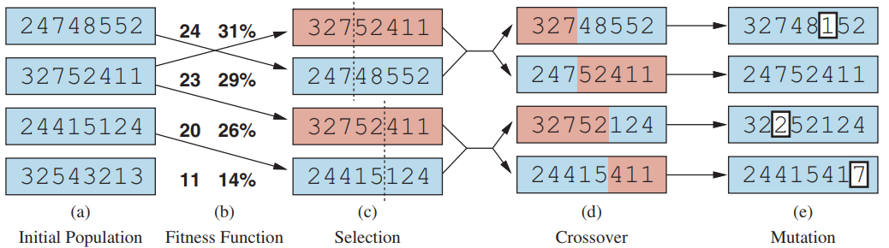
Genetic algorithm
(a) shows a population of four 8-digit strings, each representing a state of the 8-queens puzzle: the c-th digit represents the row number of the queen in column c.
In (b), each state is rated by the fitness function. Higher fitness values are better, so for the 8-queens problem we use the number of nonattacking pairs of queens, which has a value of 8×7=2 = 28 for a solution. The values of the four states in (b) are 24, 23, 20, and 11. The fitness scores are then normalized to probabilities, and the resulting values are shown next to the fitness values in (b)

Slide 21
Genetic algorithm
In (c), two pairs of parents are selected, in accordance with the probabilities in (b). Notice that one individual is selected twice and one not at all. For each selected pair, a crossover point (dotted line) is chosen randomly.
In (d), we cross over the parent strings at the crossover points, yielding new offspring. For example, the first child of the first pair gets the first three digits (327) from the first parent and the remaining digits (48552) from the second parent.
The 8-queens states involved in this recombination step are shown in the next slide.

Slide 22
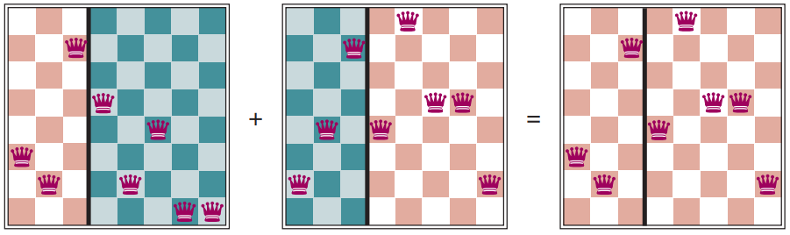
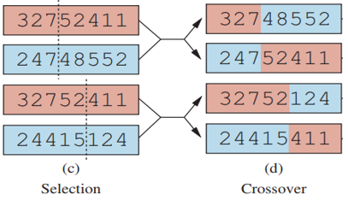
Genetic algorithm
Crossover in 8-queen puzzle
The 8-queens states corresponding to the first two parents in the previous figure (c) and the first offspring in (d). The green columns are lost in the crossover step and the red columns are retained. (To interpret the numbers the figure: row 1 is the bottom row, and 8 is the top row.)

Slide 23
Genetic algorithm
Finally, in (e), each location in each string is subject to random mutation with a small independent probability. One digit was mutated in the first, third, and fourth offspring.
In the 8-queens problem, this corresponds to choosing a queen at random and moving it to a random square in its column.
It is often the case that the population is diverse early on in the process, so crossover frequently takes large steps in the state space early in the search process (as in simulated annealing). After many generations of selection towards higher fitness, the population becomes less diverse, and smaller steps are typical.

Slide 24
Genetic algorithm
Genetic algorithms are similar to stochastic beam search, but with the addition of the crossover operation. This is advantageous if there are blocks that perform useful functions.
For example, it could be that putting the first three queens in positions 2, 4, and 6 (where they do not attack each other) constitutes a useful block that can be combined with other useful blocks that appear in other individuals to construct a solution.
It can be shown mathematically that, if the blocks do not serve a purpose—for example if the positions of the genetic code are randomly permuted—then crossover conveys no advantage.

Slide 25
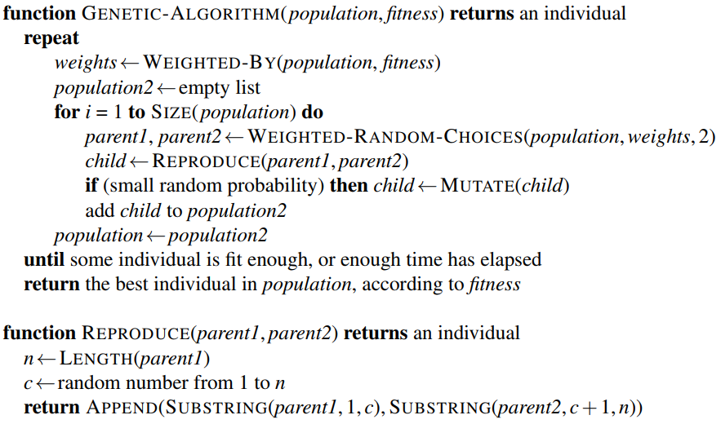
Genetic algorithm
population is an ordered list of individuals
weights is a list of corresponding fitness values
Selection
Recombination
fitness is a function to compute these weights
Mutation
Next generation

Slide 26
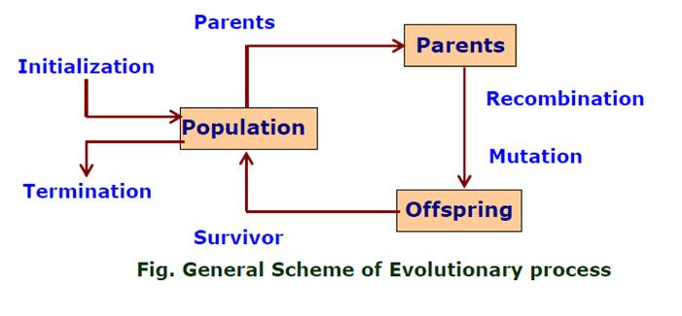
GA: FLOW-CHART

Slide 27
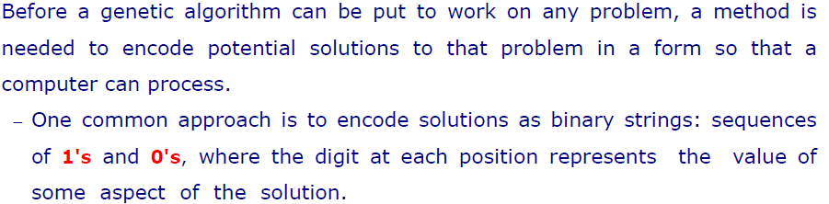
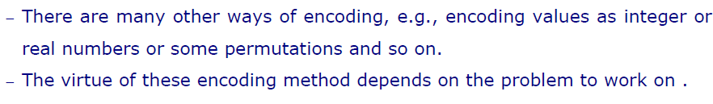
ENCODING

Slide 28
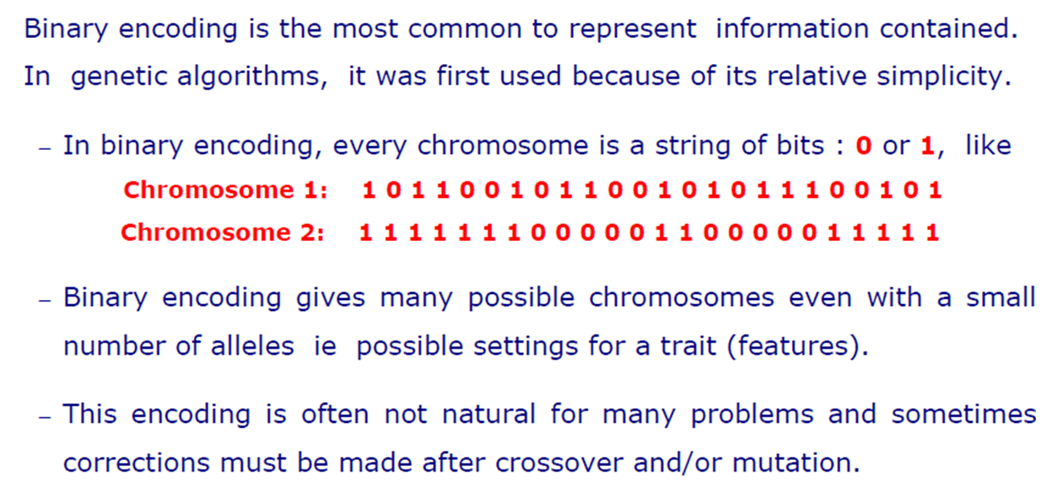
BINARY ENCODING

Slide 29
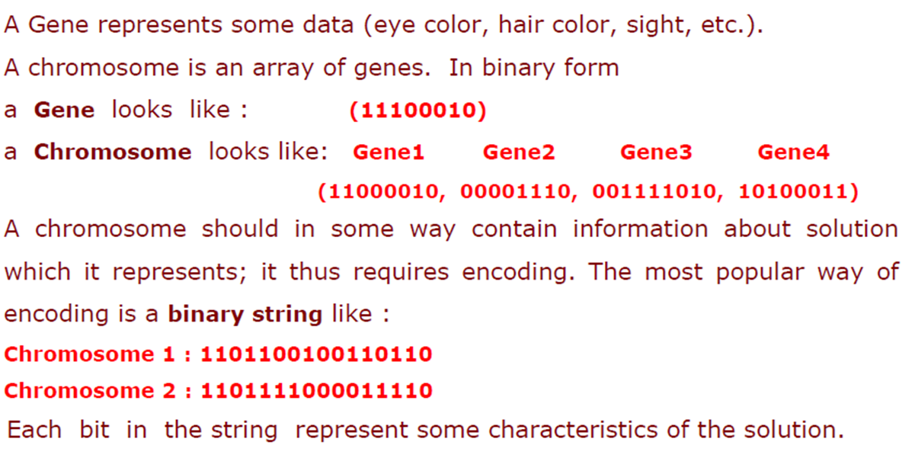
Example: Binary Encoding

Slide 30
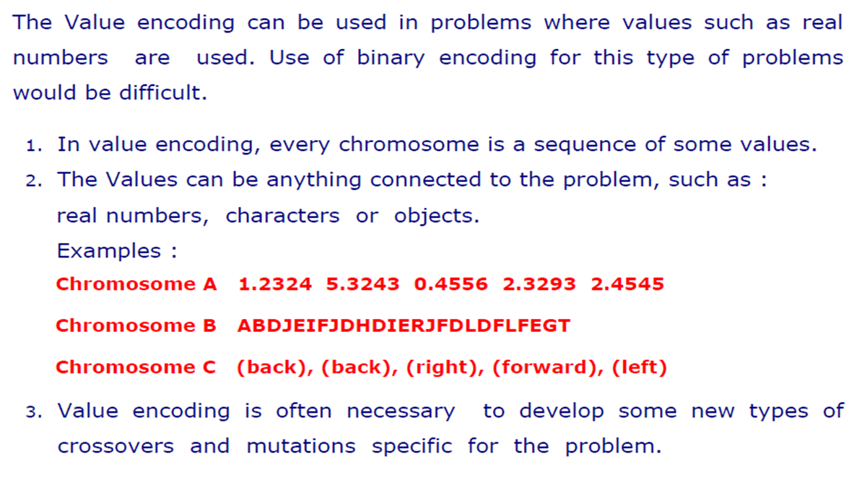
Value Encoding

Slide 31
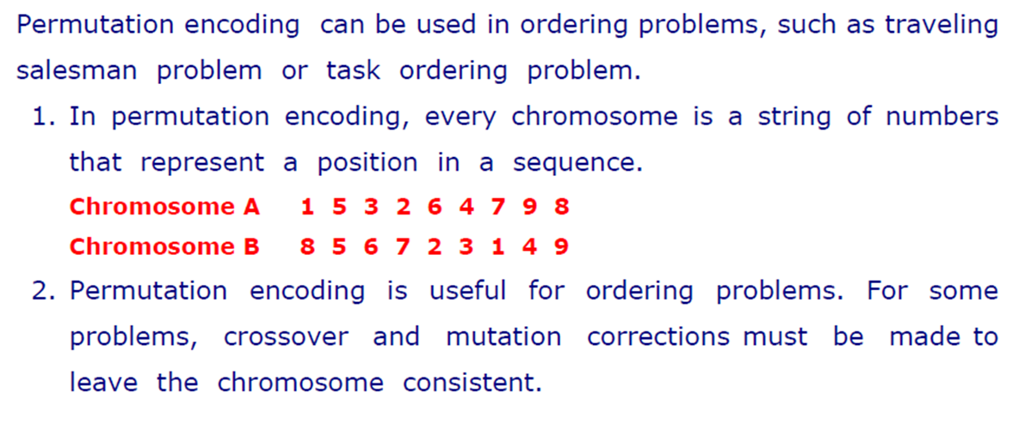
Permutation Encoding

Slide 32
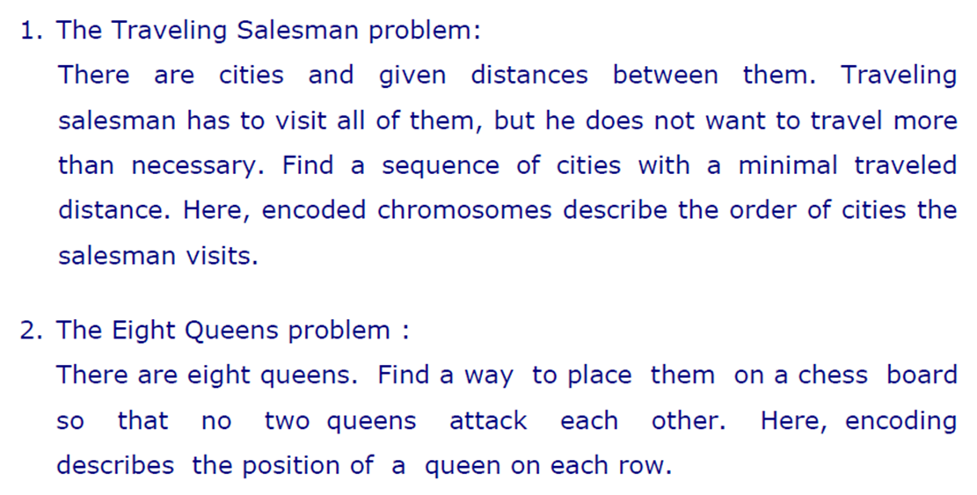
Examples: Permutation Encoding

Slide 33
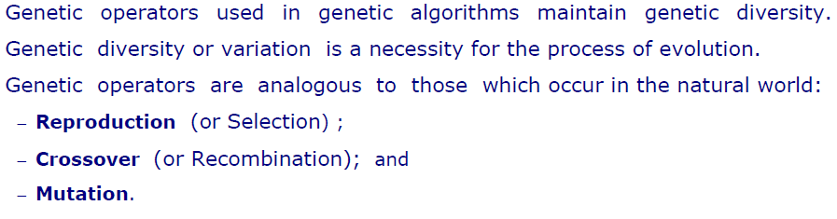
Operators of GA

Slide 34
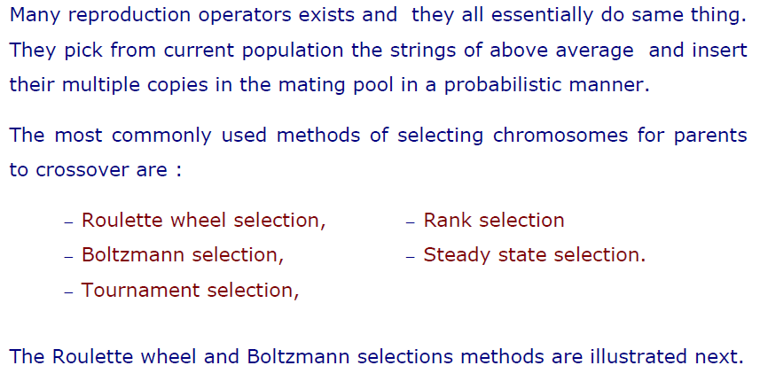
Selection

Slide 35
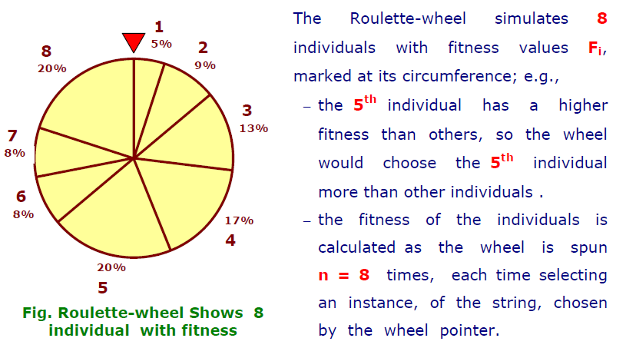
Roulette Wheel Selection

Slide 36
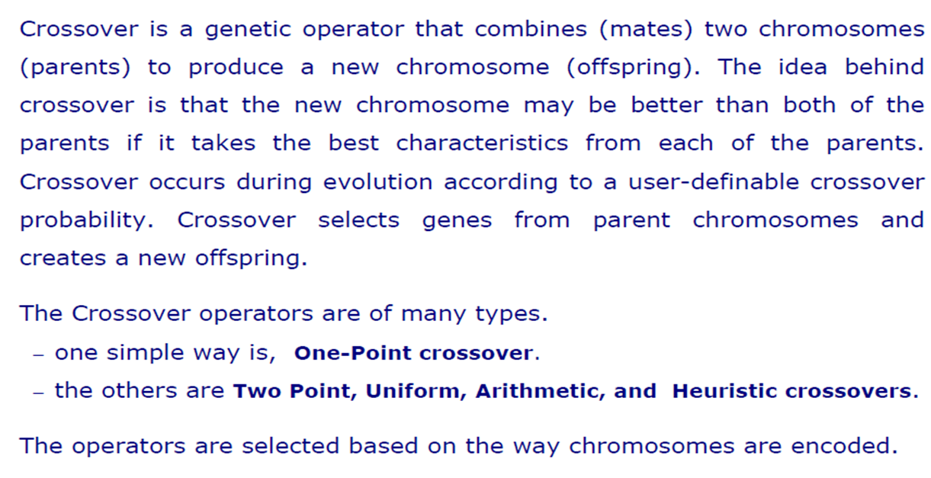
Crossover

Slide 37
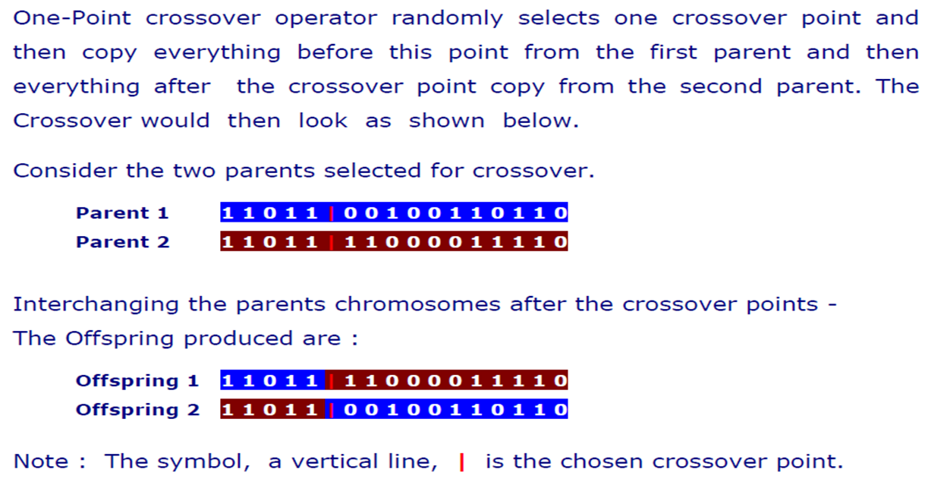
One-Point Crossover

Slide 38
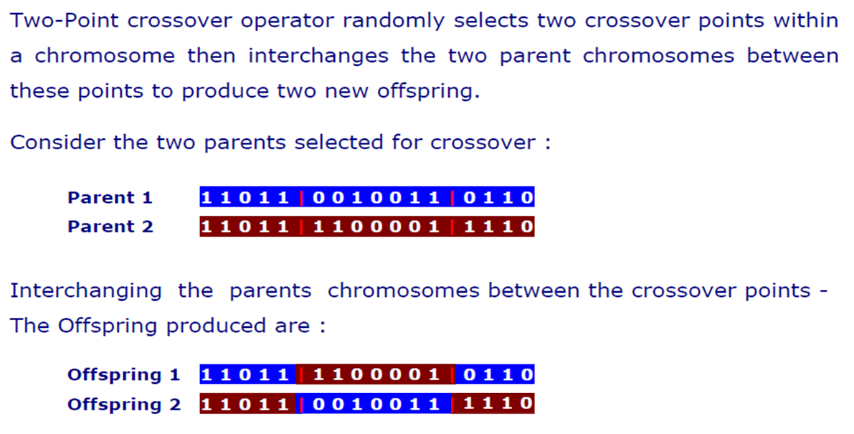
Two-Point Crossover

Slide 39
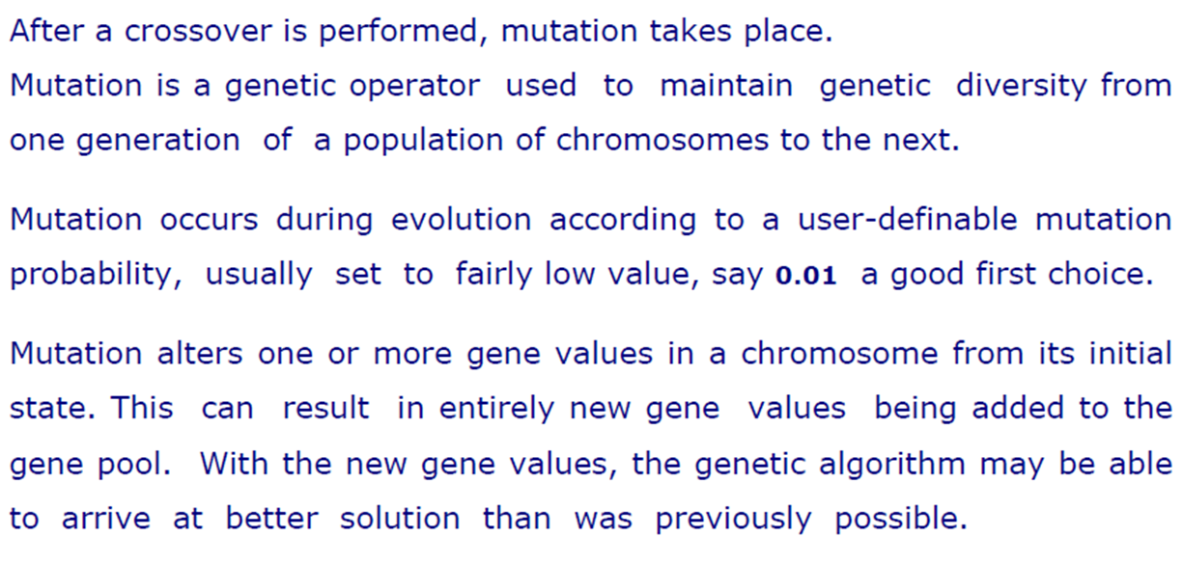
Mutation

Slide 40
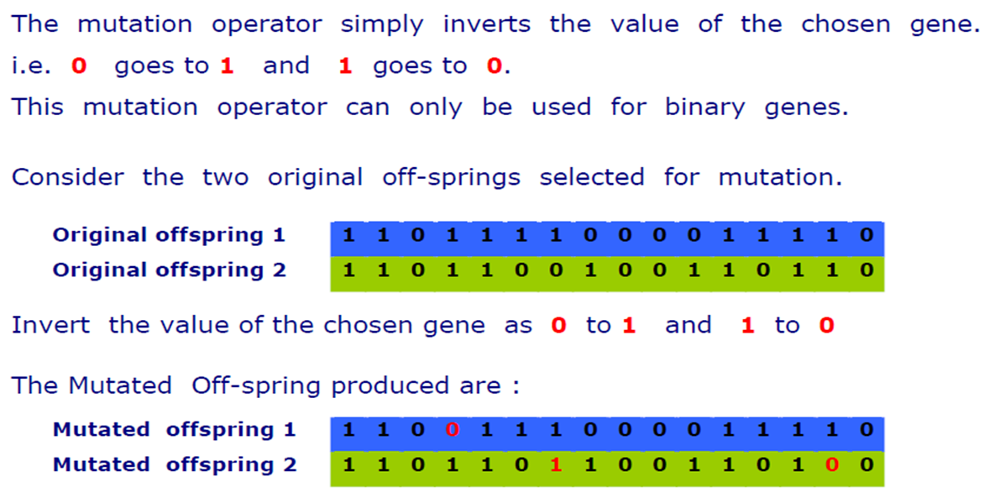
Flip Bit Mutation

Slide 41

GA Demonstration
Maximize $f\left(x\right)=\frac{x^{2}}{2}−3x$, when x in [1 to 31]
Representation of solution ??
Initialization of Population
1. Selection
2. Crossover/Recombination
3. Mutation
4. Survival/Accept
Update Population
An iteration

Slide 42
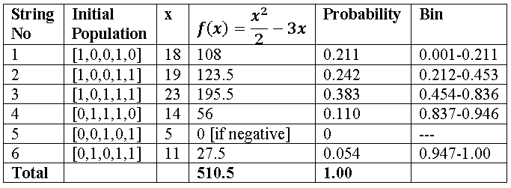
GA Demonstration
Initialize Population, fitness calculation and bin calculation
A solution is represented by 5 bits binary string
Fitness

Slide 43
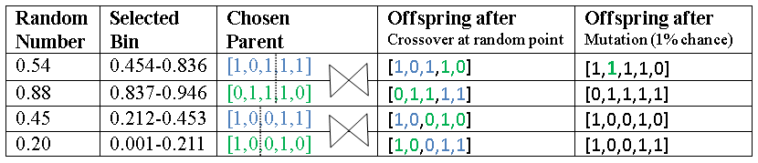
GA Demonstration
Selection, Crossover and Mutation

Slide 44
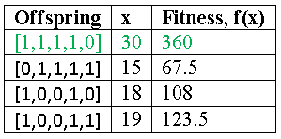
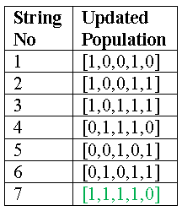
GA Demonstration
Accept/Survival and update population for the next generation
Previous population
Check termination Condition if satisfied stop otherwise repeat the process

Slide 45
Books
“Artificial Intelligence: A Modern Approach,” by Stuart J. Russell and Peter Norvig.
"Artificial Intelligence: Structures and Strategies for Complex Problem Solving", by George F. Luger, (2002)
"Artificial Intelligence: Theory and Practice", by Thomas Dean.
"AI: A New Synthesis", by Nils J. Nilsson.
“Programming for machine learning,” by J. Ross Quinlan,
“Neural Computing Theory and Practice,” by Philip D. Wasserman, .
“Neural Network Design,” by Martin T. Hagan, Howard B. Demuth, Mark H. Beale, .
“Practical Genetic Algorithms,” by Randy L. Haupt and Sue Ellen Haupt.
“Genetic Algorithms in Search, optimization and Machine learning,” by David E. Goldberg.
"Computational Intelligence: A Logical Approach", by David Poole, Alan Mackworth, and Randy Goebel.
“Introduction to Turbo Prolog”, by Carl Townsend.

